Slide 1

Pandas DataFrames
Optional Lesson 7
Slides By Samantha Klasfeld
(Please Sign in)

Slide 2
Previously on GCB Bootcamp
Defining custom functions
Hopefully you have already installed Pandas to your Desktop…

Slide 3
Today’s Schedule
Creating a Pandas DataFrame
Selecting an Index or Column From a DataFrame
Writing DataFrames

Slide 4
A DataFrame is a Virtual Table
 | Column A | Column B | Column C
Row 1 | value or NaN | value or NaN | value or NaN
Row 2 | value or NaN | value or NaN | value or NaN
Row 3 | value or NaN | value or NaN | value or NaN
Row 4 | value or NaN | value or NaN | value or NaN

Slide 5
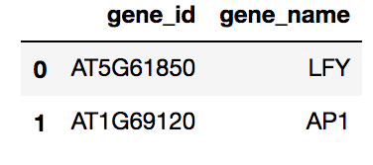
DataFrame Syntax
{
indexes
(AKA row names)

Slide 6
DataFrame Syntax
{
column names
{
indexes
(AKA row names)

Slide 7
DataFrame Syntax
{
column names
{
indexes
(AKA row names)
Values

Slide 8
There are several ways to create a pandas DataFrame

Slide 9
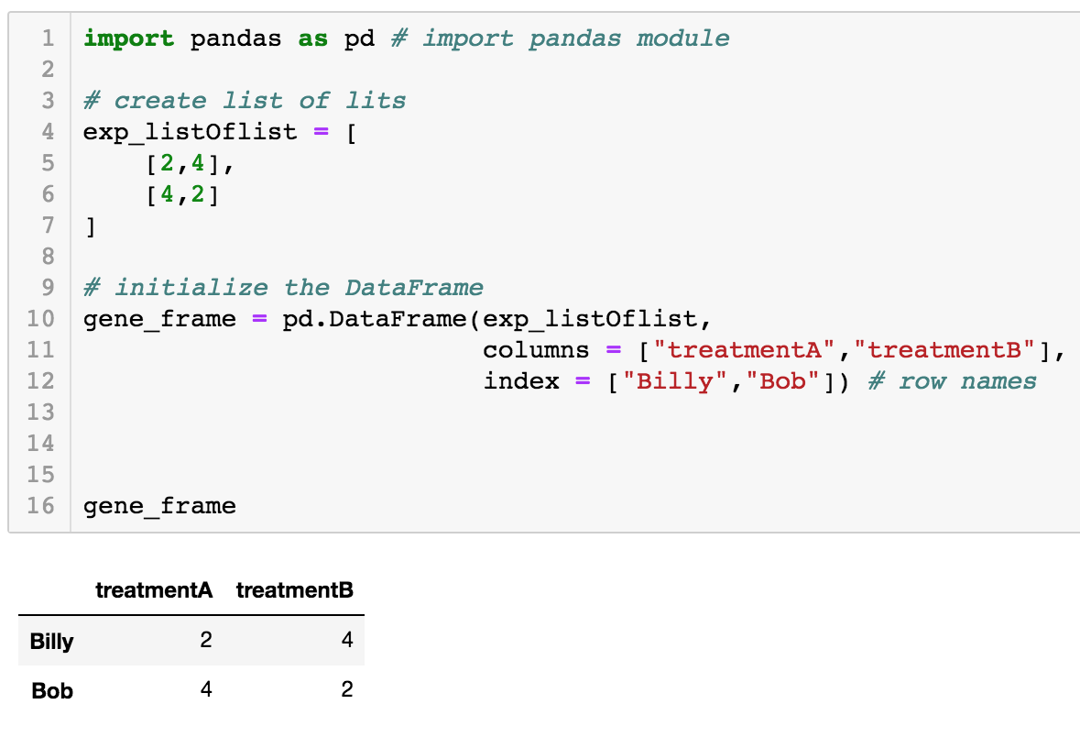
We can create a DataFrame from a List of Lists

Slide 10
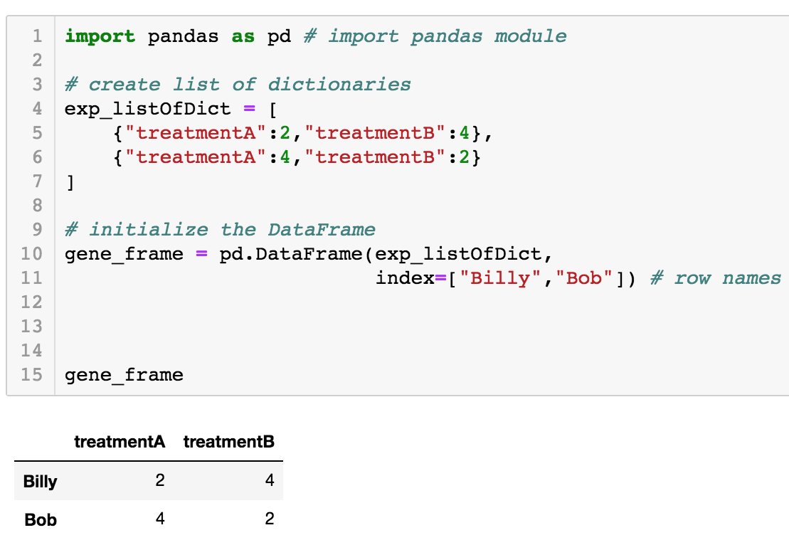
Or we can create a DataFrame from a List of Dictionaries

Slide 11
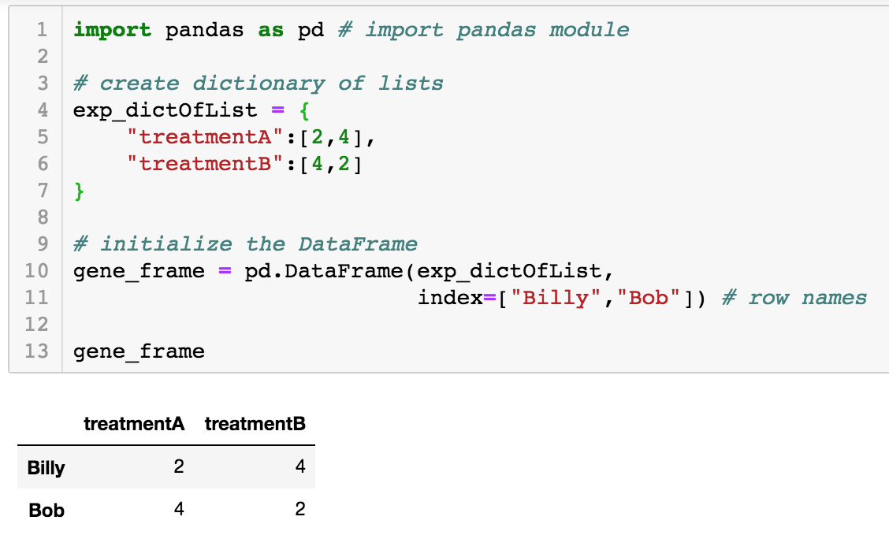
Or we can create a DataFrame from a Dictionary of Lists

Slide 12
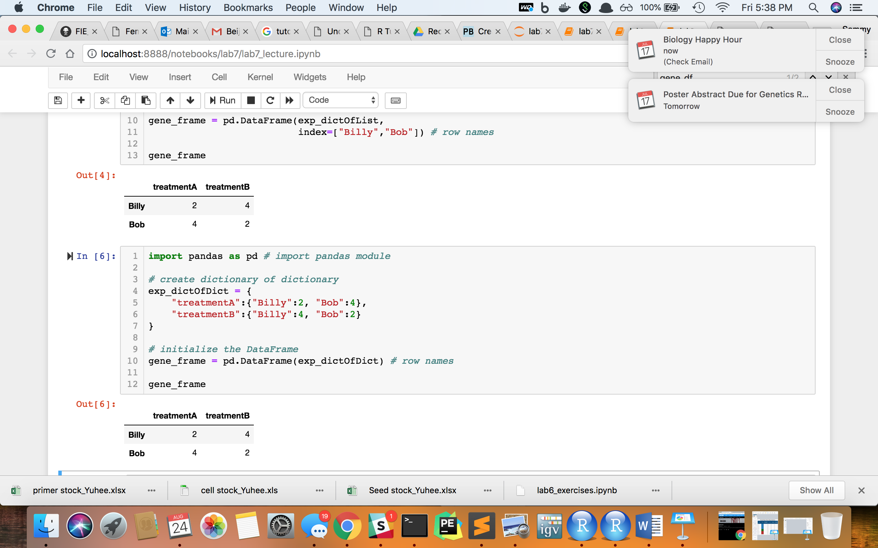
Or we can create a DataFrame from a Dictionary of Dictionaries

Slide 13
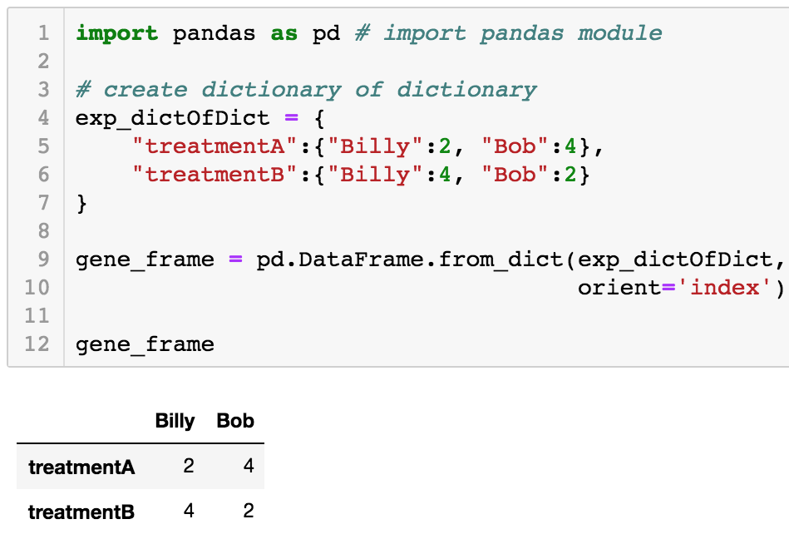
To custom orient a dataFrame using a dictionary use the .from_dict() function

Slide 14
Import pandas DataFrame from files
For example, lets say we have this bed file “example.bed” filled with genes.
Note that a bed file is tab-delimited. In this case the columns are ordered as such:
Chromosome Location
Start Location
Stop Location
Name of Feature
Score (in this case this column is uninformative)
Feature Strand
examble.bed
Chr1 | 1100 | 1600 | GeneA | 255 | +
Chr2 | 15230 | 15342 | GeneB | 255 | -
Chr2 | 15352 | 15455 | GeneC | 255 | +
Chr2 | 17006 | 18110 | GeneD | 255 | +
Chr3 | 10704 | 11671 | GeneE | 255 | -

Slide 15
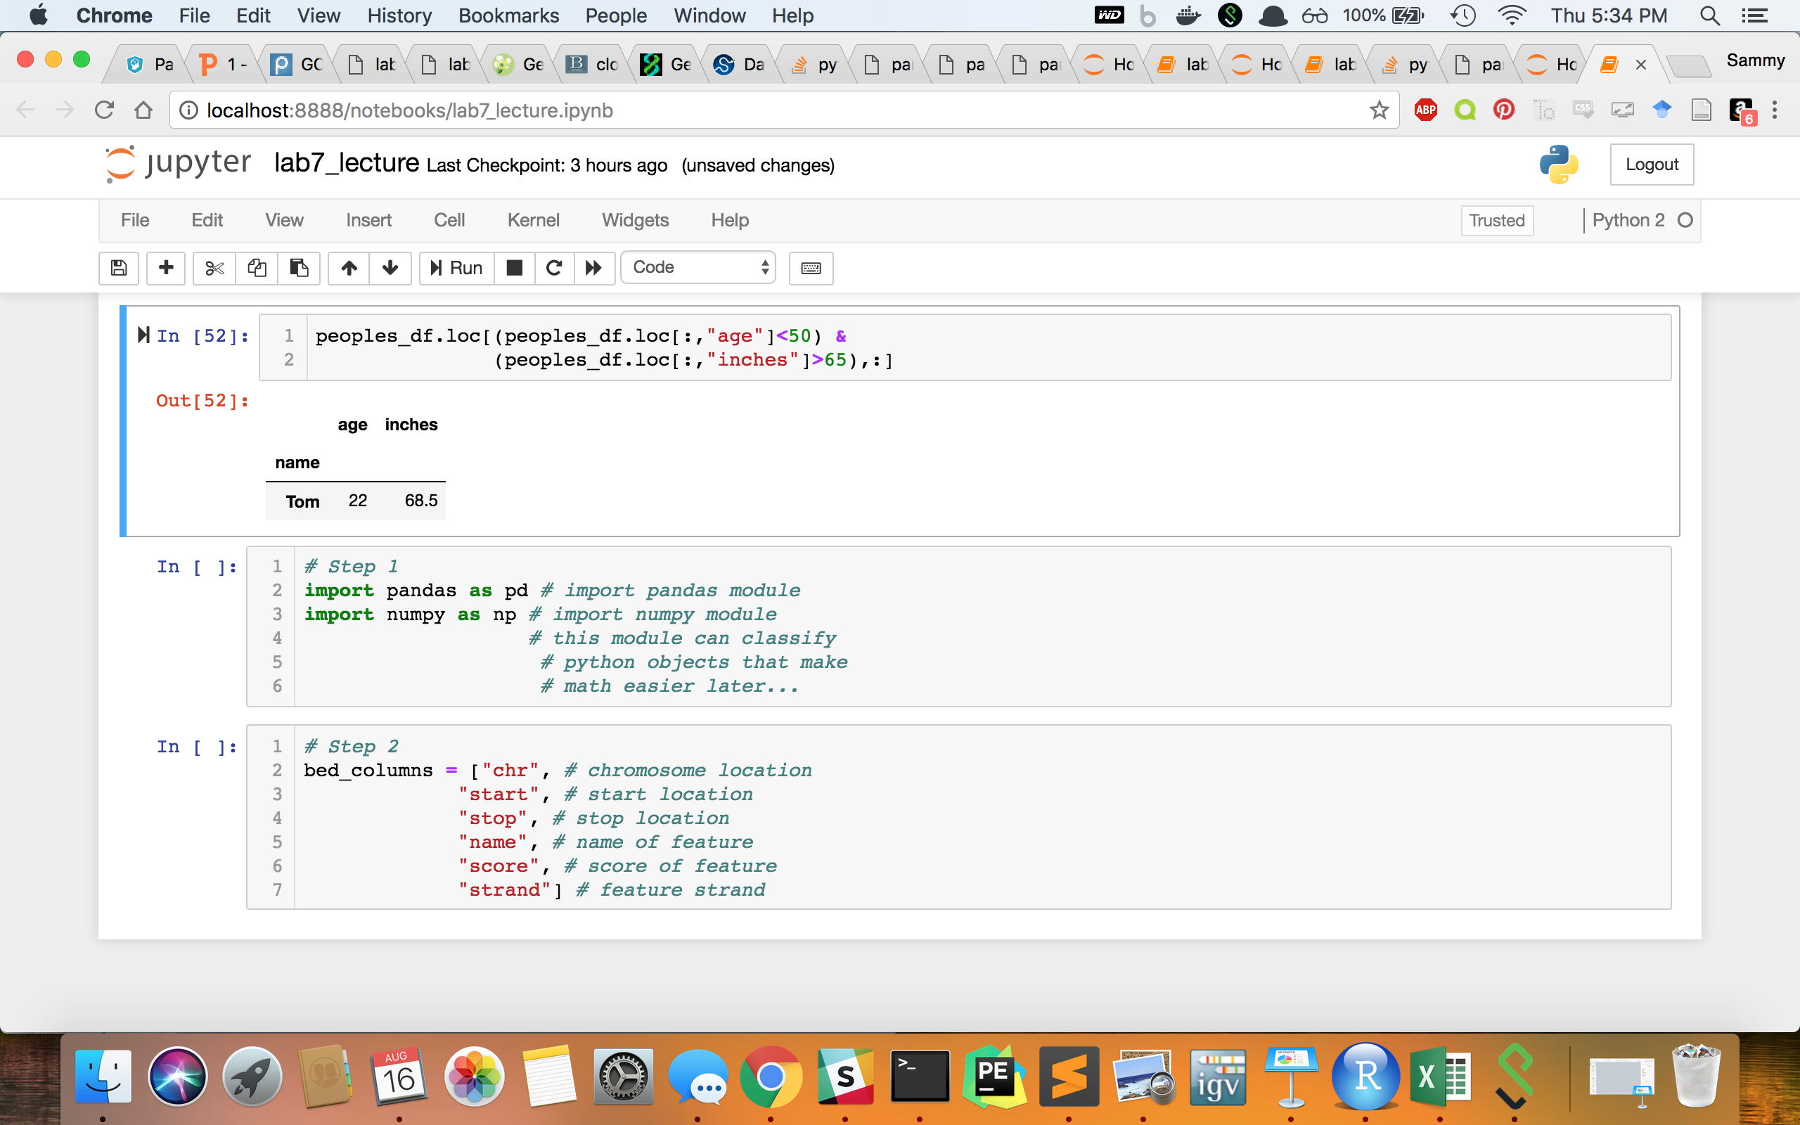
Step 1: Import Modules

Slide 16
Step 1: Import Modules
Note that pd is an alias for pandas and np is an alias for numpy now

Slide 17
Step 2: Make a list of the column names

Slide 18
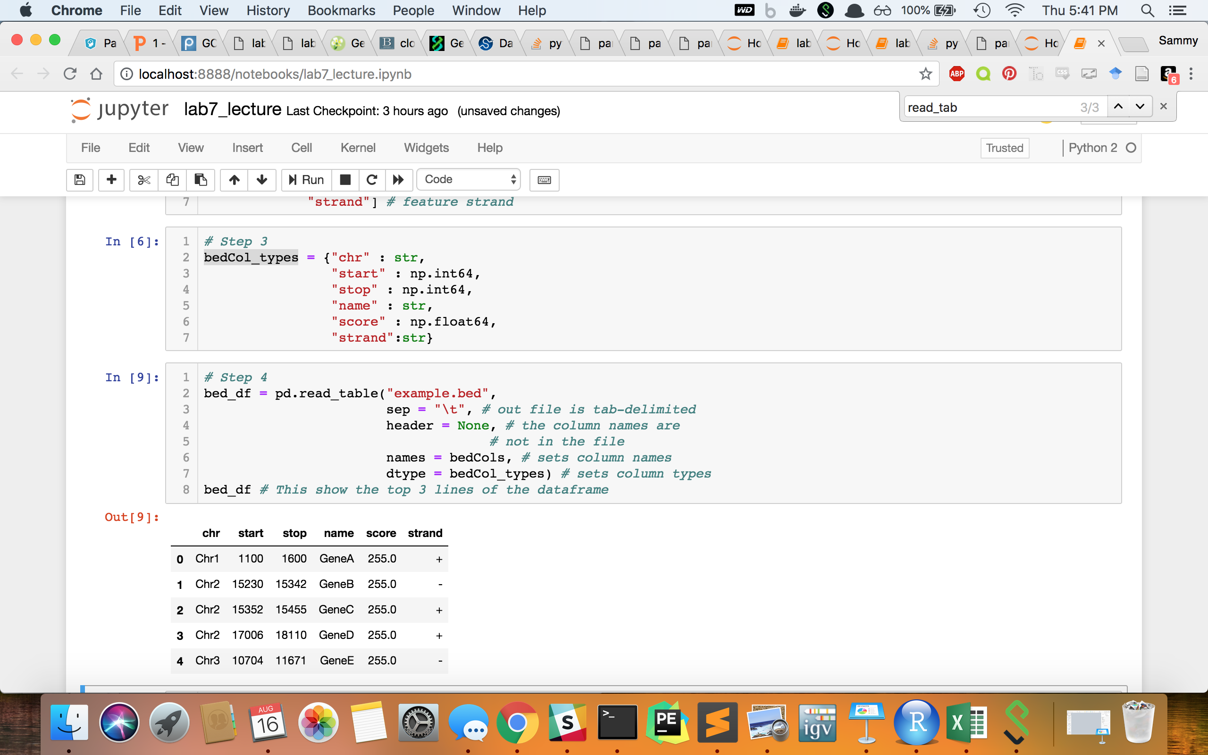
Step 3: Create a dictionary containing the data-type of each columns
(Otherwise python automatically classifies them and its NOT always right!)

Slide 19
Step 4: Read the table into Pandas!
There are many more parameters one can set for the function `pandas.read_table`, but I do not have time to go through them all. If you google “pandas read_table” you find in-depth explanations at http://pandas.pydata.org/pandas-docs/stable/.

Slide 20
Basic DataFrame Functions
bed_df.head(n=X) : gets the first X rows (default: n=5 if not stated)
bed_df.tail(n=X) : gets the last X rows (default: n=5 if not stated)
bed_df.columns : gets column names
bed_df.rows : gets row names
bed_df.dtypes : gets datatypes of each column
bed_df.shape : gets height and width of the DataFrame in a list format
len(bed_df) : gets the height of the DataFrame

Slide 21
Selecting an Index or Column From a DataFrame using .iloc & .loc
.iloc - command to get values in DataFrame based on row and column locations
.loc - command to get values in DataFrame based on row values and column values

Slide 22
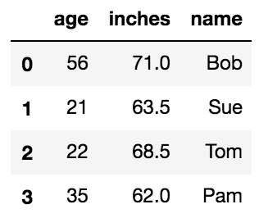
Which rows will print after the following command (from which row indexes)?
1 import pandas as pd
2 peoples_df = pd.DataFrame(
3 {"name" : ["Bob", "Sue", "Tom", “Pam”],
4 "age" : [56, 21, 22, 35],
5 "inches" : [71, 63.5, 68.5, 62]})
6 peoples_df
1 peoples_df.iloc[range(1,3),:]

Slide 23
Which rows will print after the following command (from which row indexes)?
1 import pandas as pd
2 peoples_df = pd.DataFrame(
3 {"name" : ["Bob", "Sue", "Tom", “Pam”],
4 "age" : [56, 21, 22, 35],
5 "inches" : [71, 63.5, 68.5, 62]})
6 peoples_df
variable name for DataFrame
1 peoples_df.iloc[range(1,3),:]

Slide 24
Which rows will print after the following command (from which row indexes)?
1 import pandas as pd
2 peoples_df = pd.DataFrame(
3 {"name" : ["Bob", "Sue", "Tom", “Pam”],
4 "age" : [56, 21, 22, 35],
5 "inches" : [71, 63.5, 68.5, 62]})
6 peoples_df
variable name for DataFrame
1 peoples_df.iloc[range(1,3),:]
get values in DataFrame based on row and column locations

Slide 25
Which rows will print after the following command (from which row indexes)?
1 import pandas as pd
2 peoples_df = pd.DataFrame(
3 {"name" : ["Bob", "Sue", "Tom", “Pam”],
4 "age" : [56, 21, 22, 35],
5 "inches" : [71, 63.5, 68.5, 62]})
6 peoples_df
variable name for DataFrame
1 peoples_df.iloc[range(1,3),:]
get values in DataFrame based on row and column locations
This gives a range of numbers from 1-2 for row locations

Slide 26
Which rows will print after the following command (from which row indexes)?
1 import pandas as pd
2 peoples_df = pd.DataFrame(
3 {"name" : ["Bob", "Sue", "Tom", “Pam”],
4 "age" : [56, 21, 22, 35],
5 "inches" : [71, 63.5, 68.5, 62]})
6 peoples_df
variable name for DataFrame
1 peoples_df.iloc[range(1,3),:]
get values in DataFrame based on row and column locations
This gives a range of numbers from 1-2 for row locations
This symbol represents all of the columns

Slide 27

Which rows will print after the following command (from which row indexes)?
1 import pandas as pd
2 peoples_df = pd.DataFrame(
3 {"name" : ["Bob", "Sue", "Tom", “Pam”],
4 "age" : [56, 21, 22, 35],
5 "inches" : [71, 63.5, 68.5, 62]})
6 peoples_df
1 peoples_df.iloc[range(1,3),:]
ANSWER: This prints rows with indexes 1 & 2
since they are the second and third row

Slide 28
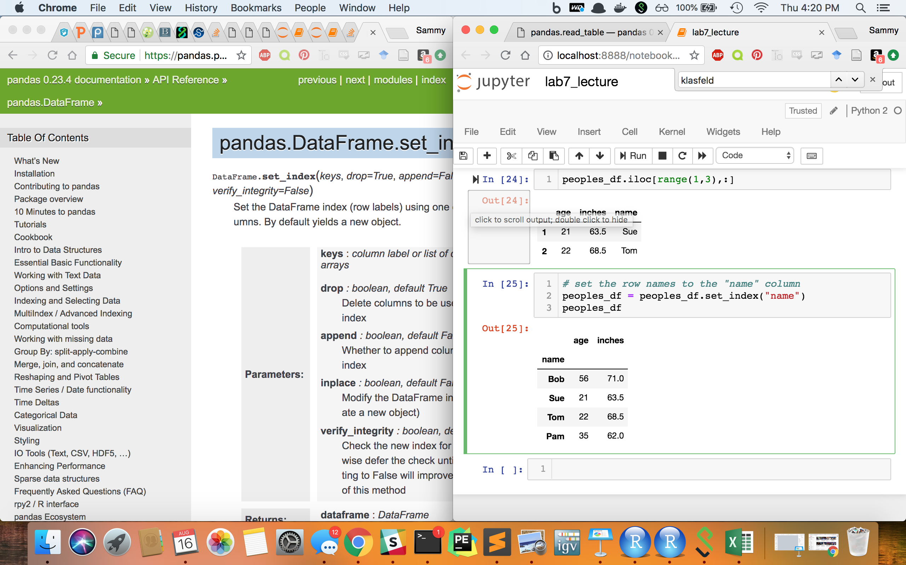
Which rows will print after the following command?
1 peoples_df.loc[range(1,3),:]

Slide 29
Which rows will print after the following command?
1 peoples_df.loc[range(1,3),:]
ANSWER: This also prints rows with indexes 1 & 2
since the value of these row indexes are 1 & 2 respectively since we do NOT have row names

Slide 30
Setting Row Names with .set_index

Slide 31
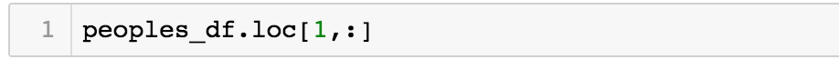
Which rows will print after the following command?

Slide 32
Which rows will print after the following command?
ANSWER: This prints an ERROR since there is no row name “1”

Slide 33
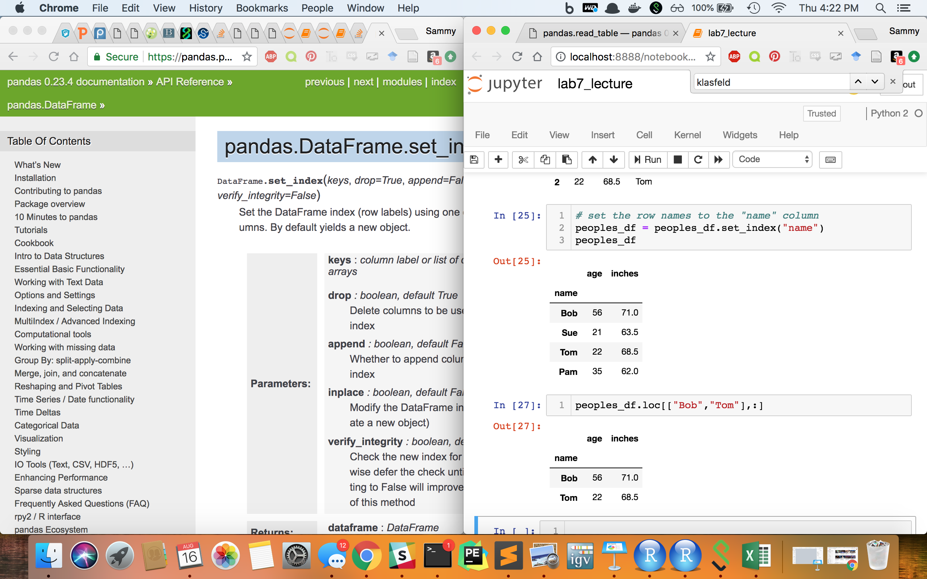
Which rows will print after the following command?

Slide 34
Which rows will print after the following command?
ANSWER: This prints the rows with row names “Bob” and “Tom”

Slide 35
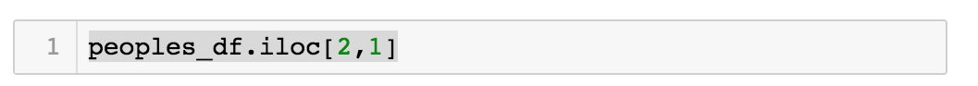
What value would this print?

Slide 36
What value would this print?
ANSWER: 68.5

Slide 37
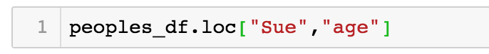
What value would this print?

Slide 38
What value would this print?
ANSWER: 21

Slide 39
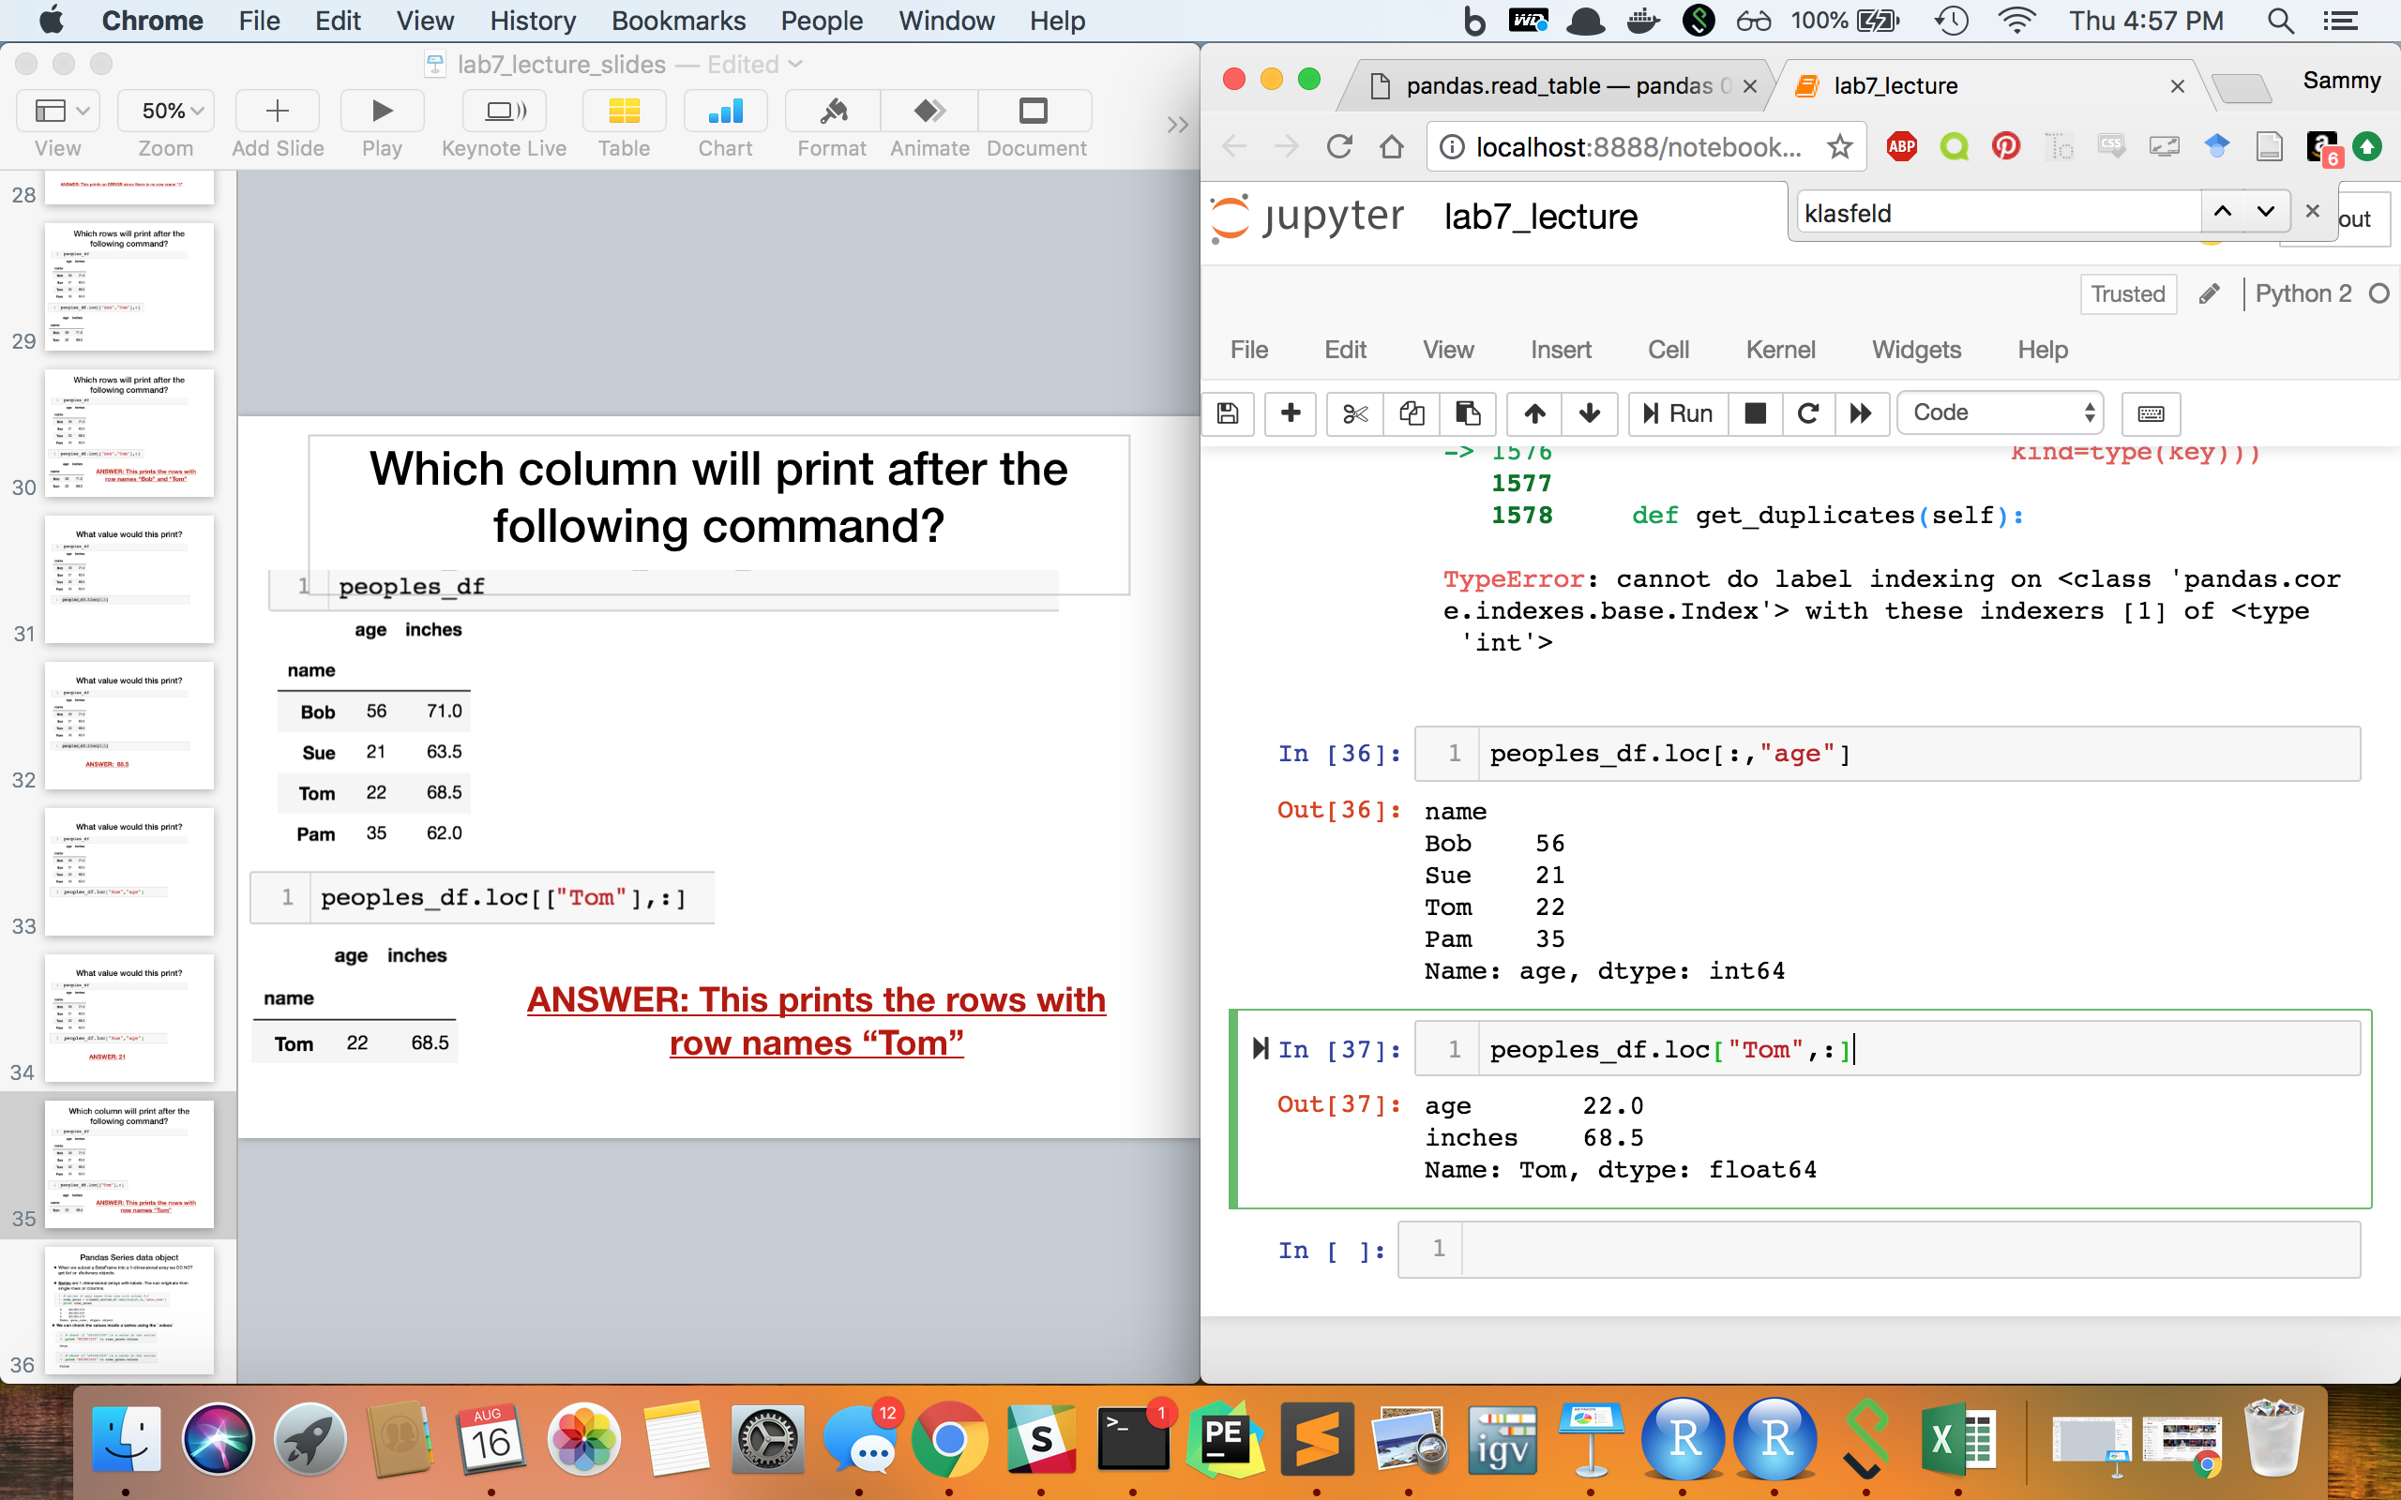
Which column will print after the following command?

Slide 40
Which column will print after the following command?
ANSWER: The “age” column
But why is the output formatted differently?

Slide 41
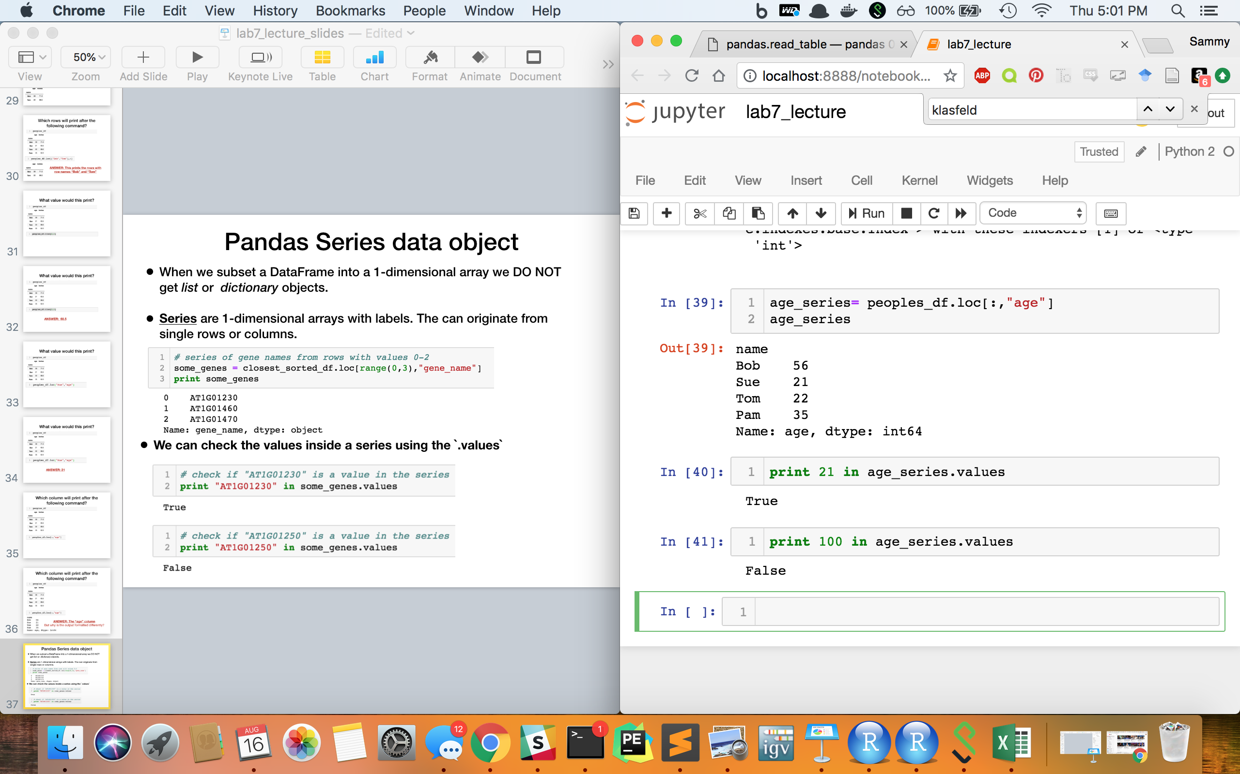
Pandas Series data object
When we subset a DataFrame into a 1-dimensional array we DO NOT get list or dictionary objects.
Series are 1-dimensional arrays with labels. They can originate from single rows or columns.
We can check the values inside a series using the `.values` function

Slide 42
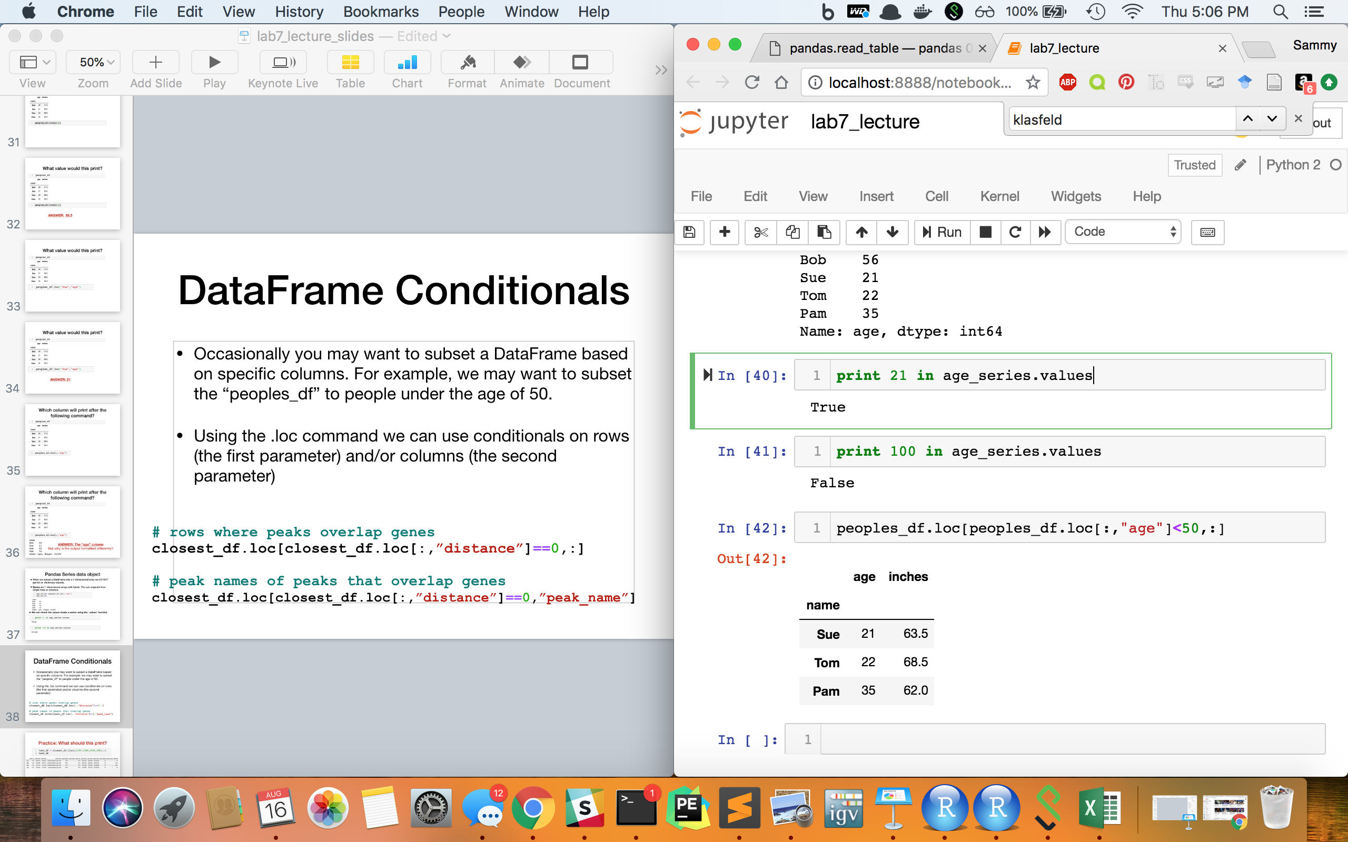
DataFrame Conditionals
Occasionally you may want to subset a DataFrame based on specific columns. For example, we may want to subset the “peoples_df” to people under the age of 50.
Using the .loc command we can use conditionals on rows (the first parameter) and/or columns (the second parameter)

Slide 43
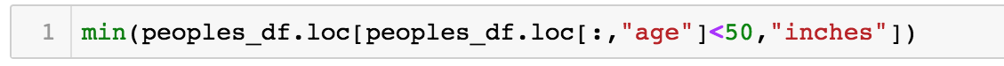
What value would this print?

Slide 44
What value would this print?
ANSWER: 62.0

Slide 45
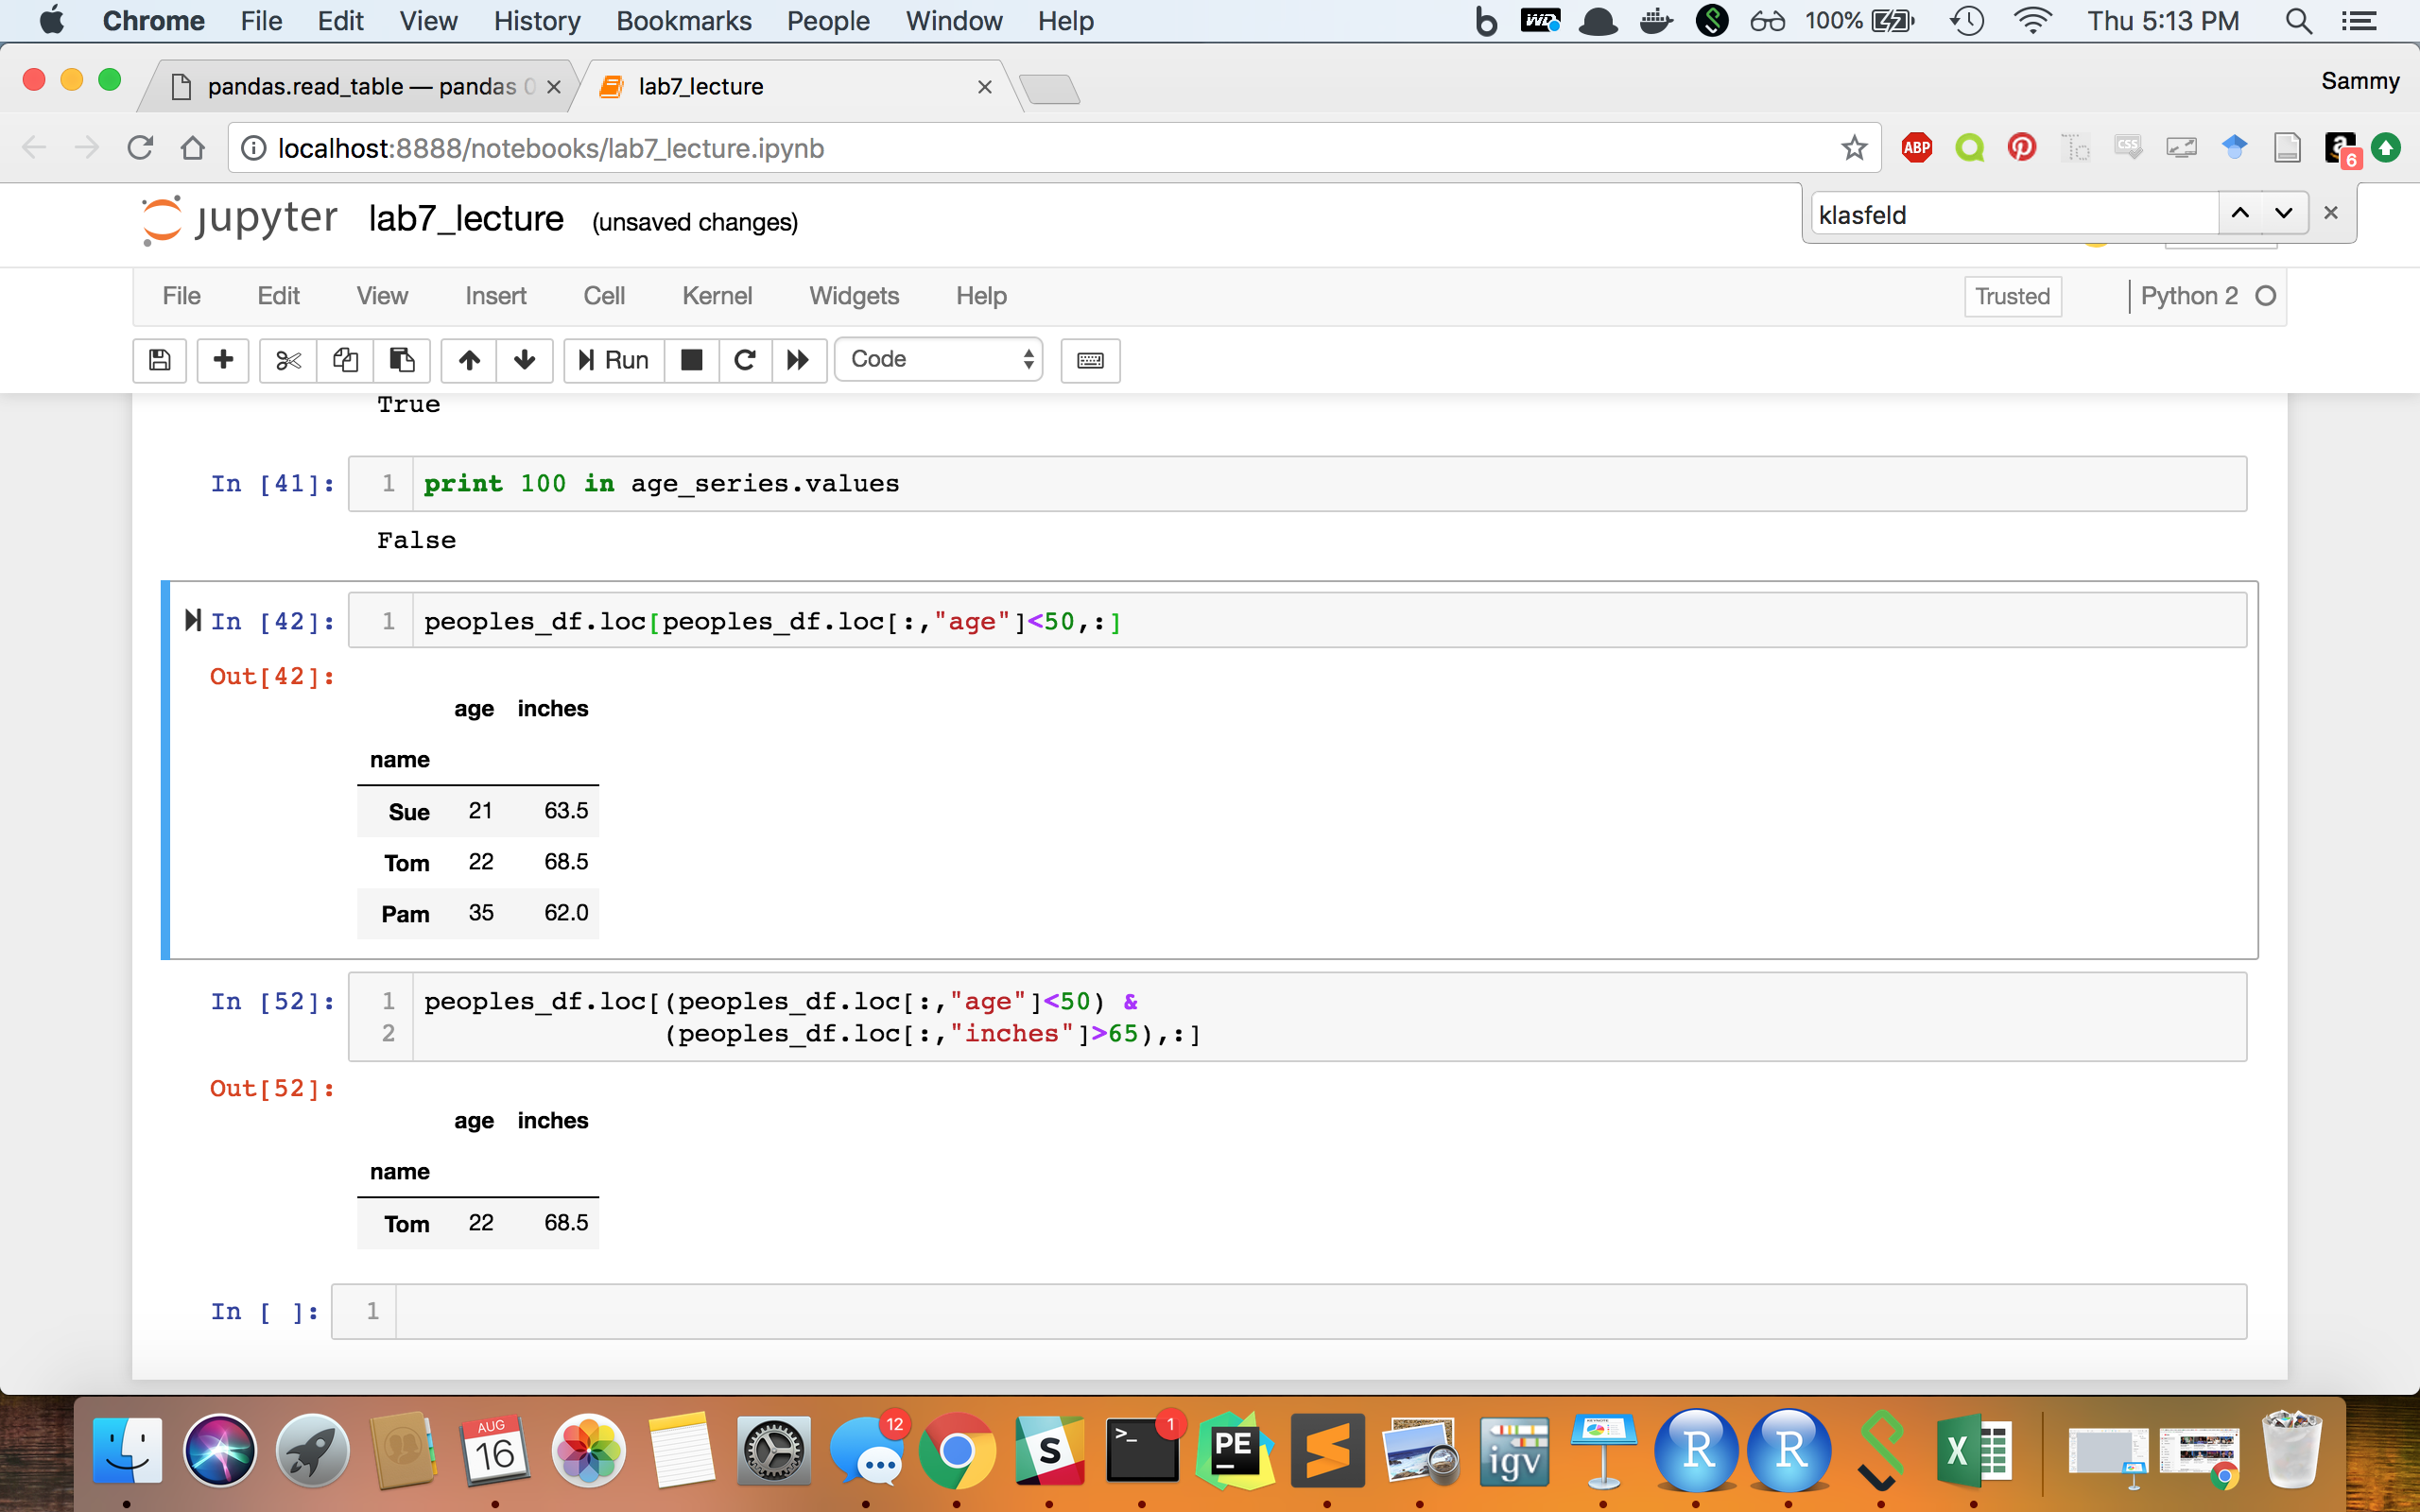
What row(s) would this print?
Note: for multiple conditions inside
.loc or .iloc we only use a single ampersand

Slide 46
What row(s) would this print?
ANSWER:

Slide 47
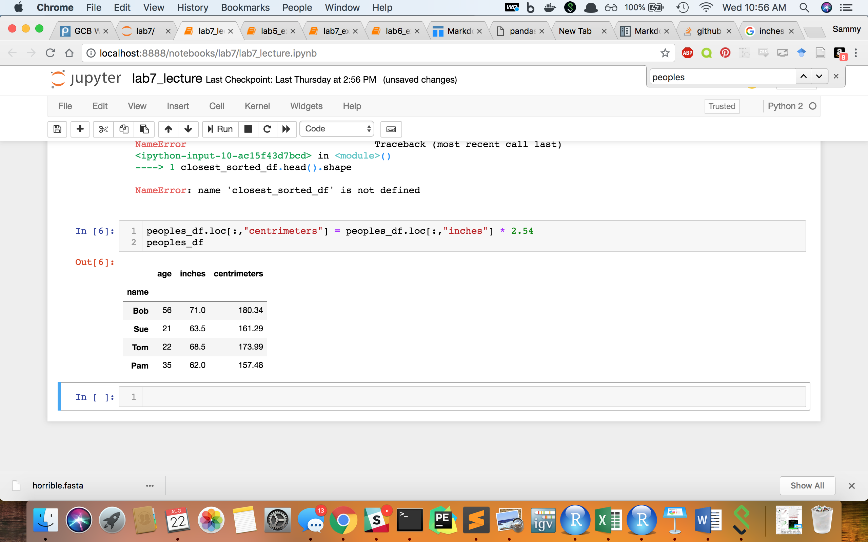
Creating New Columns
You can also add columns using the .loc and .iloc commands.
For example, we can add a row for height in “centimeters” in addition to inches

Slide 48
Exporting a DataFrame to a File
Similar to importing a text file to a pandas DataFrame, there are also several parameters for exporting a pandas DataFrame.
The syntax for exporting a DataFrame is :
dataFrame.to_csv(path_to_outputFile, arguments)
For example, to export a tab-delimited file from DataFrame `test_df` with a header and no row-names to the file “test.txt” we use the command:
test_df.to_csv(“test.txt”, sep=“\t”, header=True, index=False)

Slide 49
Summary
We can build pandas DataFrames in python using dictionaries or files
We can subset these DataFrames using .iloc or .loc
We can export these DataFrames to a File

Slide 50
What else can we do with Pandas?
Sort tables by specific columns
Merge two DataFrames together using the .join() function
Group series together using .groupby() function
Create plots and visualizations using the matplotlib() library
and more! Just google it! (eg. http://pandas.pydata.org/pandas-docs/stable/)

Slide 51
The End?

Slide 52
Next Lecture
Merge two DataFrames together using the .join() function
Group series together using .groupby() function

